Slide 1
PROTOTYPE DEVELOPMENT II
SESSION V
FEEDBACK

Slide 2
Learning Objectives
LO 1 : Design physical / visual representation and constructive breakthrough of business ideas

Slide 3
Subtopics
Test
Feedback Grid

Slide 4
Test

Slide 5
Test
The “Test” phase is about testing the prototype(s) with users
The prototype represents only the current knowledge and assumptions the team has about the user

Slide 6
Feedback Grid

Slide 7
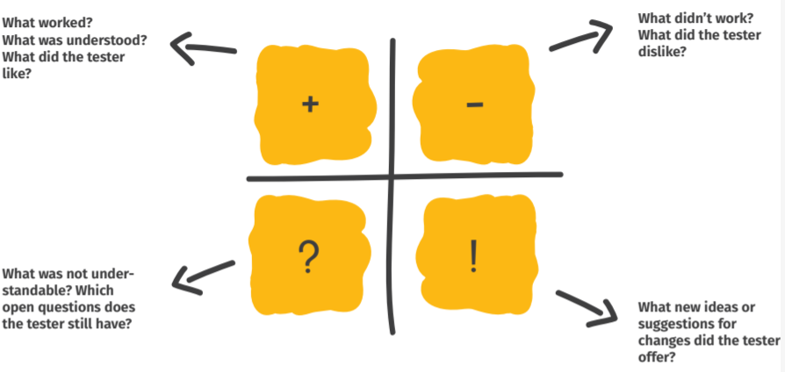
Feedback Grid
To collect user feedback for future iteration steps

Slide 8
Student Activities

Slide 9
Student Activities
Students learn about how to create feedback grid to test their business

Slide 10
Session 7 Preparation

Slide 11
Session 7 Preparation
Selected teams will explain their prototype for maximum 7 minutes per team on video conference session
Students create a 3-minute video that explains their prototype
Test the prototype to minimum 3 classmates and 2 lecturers
Create feedback grid and the analysis based on the testing results

Slide 12
References
Knapp, J., Zeratsky, J., & Kowitz, B. (2016). Sprint: How to solve big problems and test new ideas in just five days. Simon and Schuster
Osann, I., Mayer, L., & Wiele, I. (2020). The Design Thinking Quick Start Guide: A 6-step Process for Generating and Implementing Creative Solutions. John Wiley & Sons.
https://www.youtube.com/watch?v=5XC4JqXUJbw

